Slide 1


Recurrence Relations

Slide 2
Topic Outcomes
Explain recurrence relation and its importance
Identify the type of recurrence relations.
Solve the given recurrence relations using given initial conditions.
Apply recurrence relations to analyze complexity of algorithms.

Slide 3
The number of bacteria in a certain culture doubles
every hour. If there were 30 bacteria present in the
culture originally, how many bacteria will be present
at the end of 2nd hour, 4th hour and nth hour?

Slide 4
It is given that the number of bacteria doubles every hour. Therefore, the number of bacteria after every hour will form a G.P. with first term (a=30) and common ratio (r=2) ∴a^3​=ar^2=(30)(2)^2=120 Therefore, the number of bacteria at the end of 2nd hour will be 480. a5​=ar^4=(30)(2)^4=480 and an+1​=ar^n=(30)(2)^n Thus the number of bacteria at the end of nth hour will be (30)(2)^n

Slide 5
Modeling with Recurrence Relations
Example:
Someone deposits $10,000 in a savings account at a bank yielding 5% per year with interest compounded annually. How much money will be in the account after 30 years?
Solution:
Let P_{n} denote the amount in the account after n years.
How can we determine P_{n} on the basis of P_{n-1}?

Slide 6
Modeling with Recurrence Relations
We can derive the following recurrence relation:
P_{n} = P_{n-1} + 0.05P_{n-1} = 1.05P_{n-1}.
The initial condition is P₀ = 10,000.
Then we have:
P₁ = 1.05P₀
P₂ = 1.05P₁ = (1.05)²P₀
P₃ = 1.05P₂ = (1.05)³P₀
…
P_{n} = 1.05P_{n-1} = (1.05)^{n}P₀
We now have a formula to calculate P_{n} for any natural number n and can avoid the iteration.

Slide 7
Modeling with Recurrence Relations
Let us use this formula to find P₃₀ under the
initial condition P₀ = 10,000:
P₃₀ = (1.05)³⁰⋅10,000 = 43,219.42
After 30 years, the account contains $43,219.42.

Slide 8
Content
Introduction
Types of recurrence relations
linear homogeneous recurrence relation
linear non homogeneous recurrence relation
Applications of recurrence relations
Formulating Recurrence relations
Generating Functions

Slide 9
Motivating Examples: Factorial: Analysis
Consider the following (recursive) algorithm fo
computing n!
Factorial
Input: n∈N
Output: n!
If (n=1) or (n=0)
Then Return 1
Else Return n × Factorial(n-1)
Endif

Slide 10
Motivating Examples: Factorial: Analysis
How many multiplications M(x) does factorial
perform?
The number of multiplications can be expressed as a formula (similar
to the definition of n!
M(0) = 0
M(n) = 1 + M(n-1)
This relation is known as a recurrence relation

Slide 11
Recurrence Relations
Definition: A recurrence relation for the sequence {an} is an equation expressing an in terms of one or more of the previous terms of the sequence:
a1,a2,a3,…,an-1, with n>=n0, (n0 being a nonnegative integer).
A sequence is called a solution of a recurrence relation if its terms satisfy the recurrence relation.

Slide 12
Recurrence Relations
In other words, a recurrence relation is like a recursively defined sequence, but without specifying any initial values (initial conditions).
Therefore, the same recurrence relation can have (and usually has) multiple solutions.
If both the initial conditions and the recurrence relation are specified, then the sequence is uniquely determined.

Slide 13
Types of Recurrence Relations
Linear homogeneous recurrence relation
Linear non homogeneous recurrence relation

Slide 14
Linear Homogeneous Recurrences
Definition: A linear homogeneous recurrence relation
of degree k with constant coefficients is a recurrence
relation of the form
a_{n} = c₁a_{n-1} + c₂a_{n-2} + … + c_{k}a_{n-k} with c₁, c₂, …, c_{k}∈R, c_{k}≠ 0.
Linear: RHS is a sum of multiples of previous terms of the sequence The coefficients are all constants
Homogeneous: no terms occur that are not multiples of a_{j}’s
Degree k: a_{n} is expressed in terms of (n-k)^{th} term of the sequence

Slide 15
Linear NonHomogeneous Recurrences
For recursive algorithms, cost function are often not homogeneous because there is usually a non-recursive cost depending on the input size
Such a recurrence relation is called a linear nonhomogeneous recurrence relation

Slide 16
Linear Non Homogeneous Recurrences
Such functions are of the form
a_{n} = c₁a_{n-1} + c₂a_{n-2} + … + c_{k}a_{n-k} + f(n)
f(n) represents a non-recursive cost. If we chop it off, we are left with
a_{n} = c₁a_{n-1} + c₂a_{n-2} + … + c_{k}a_{n-k}

Slide 17
Linear NonHomogeneous Recurrences
Every solution of a linear nonhomogeneous recurrence relation is the sum of
a particular solution and
a solution to the associated linear homogeneous recurrence relation

Slide 18
Recurrence Relations
Example: 1)Consider the recurrence relation a_{n} = 2a_{n-1} – a_{n-2} for n = 2, 3, 4, … Is the sequence {a_{n}} with a_{n}=3n a solution of this recurrence relation? Answer the same question a_{n}=2^{n} and a_{n}=5
For n ≥ 2 we see that 2a_{n-1} – a_{n-2} = 2(3(n – 1)) – 3(n – 2) = 3n = a_{n}.
Therefore, {a_{n}} with a_{n}=3n is a solution of the recurrence relation.

Slide 19
Is the sequence {a_{n}} with a_{n}=5 a solution of the same recurrence relation?
For n ≥ 2 we see that 2a_{n-1} – a_{n-2} = 2⋅5 - 5 = 5 = a_{n}.
Therefore, {a_{n}} with a_{n}=5 is also a solution of the recurrence relation.

Slide 20
Modeling with Recurrence Relations
Another example:
Let a_{n} denote the number of bit strings of length n that do not have two consecutive 0s (“valid strings”). Find a recurrence relation and give initial conditions for the sequence {a_{n}}.
Solution:
Idea: The number of valid strings equals the number of valid strings ending with a 0 plus the number of valid strings ending with a 1.

Slide 21
Modeling with Recurrence Relations
Let us assume that n ≥ 3, so that the string contains at least 3 bits.
Let us further assume that we know the number a_{n-1} of valid strings of length (n – 1).
Then how many valid strings of length n are there, if the string ends with a 1?
There are a_{n-1} such strings, namely the set of valid strings of length (n – 1) with a 1 appended to them.
Note: Whenever we append a 1 to a valid string, that string remains valid.

Slide 22
Solving Recurrence Relations
In general, we would prefer to have an explicit formula to compute the value of a_{n} rather than conducting n iterations.
For one class of recurrence relations, we can obtain such formulas in a systematic way.
Those are the recurrence relations that express the terms of a sequence as linear combinations of previous terms.

Slide 23
Solving Recurrence Relations
Definition: A linear homogeneous recurrence relation of degree k with constant coefficients is a recurrence relation of the form:
an = c1an-1 + c2an-2 + … + ckan-k,
Where c1, c2, …, ck are real numbers, and ck ≠ 0.
A sequence satisfying such a recurrence relation is uniquely determined by the recurrence relation and the k initial conditions
a0 = C0, a1 = C1, a2 = C2, …, ak-1 = Ck-1.

Slide 24
Solving Recurrence Relations
Examples:
The recurrence relation Pn = (1.05)Pn-1
is a linear homogeneous recurrence relation of degree one.
The recurrence relation fn = fn-1 + fn-2
is a linear homogeneous recurrence relation of degree two.
The recurrence relation an = an-5
is a linear homogeneous recurrence relation of degree five.

Slide 25
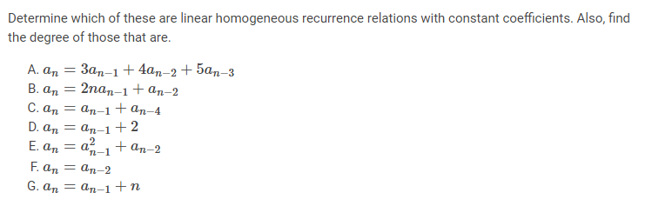
Identify the type of equation

Slide 26
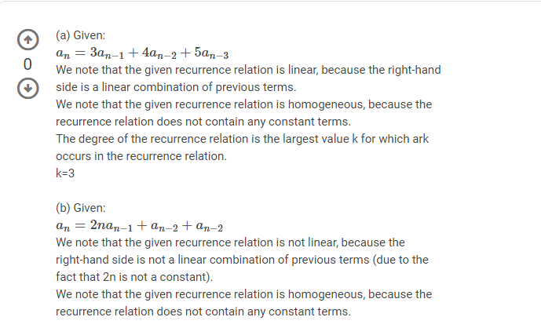

Slide 27
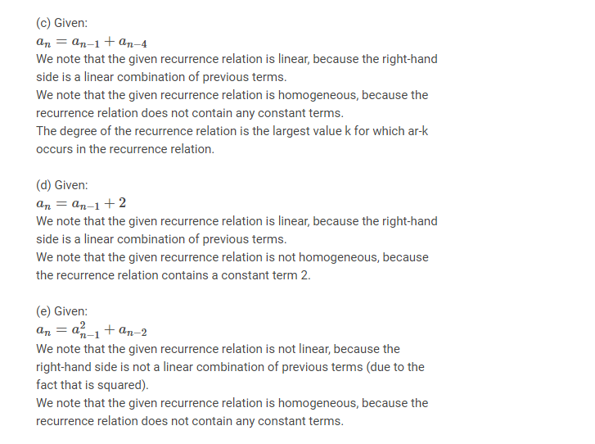

Slide 28
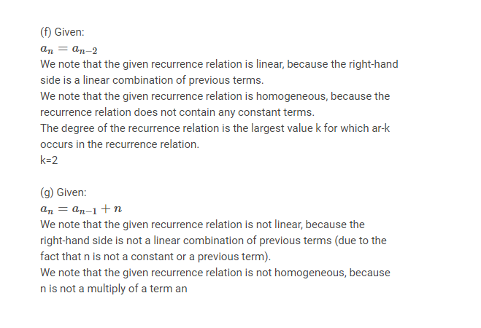

Slide 29
an=3an−1+4an−2+5an−3an=3an−1+4an−2+5an−3 We note that the given recurrence relation is linear, because the right-hand side is a linear combination of previous terms. We note that the given recurrence relation is homogeneous, because the recurrence relation does not contain any constant terms. The degree of the recurrence relation is the largest value k for which ark occurs in the recurrence relation. k=3

Slide 30
Then what about following:
1)an=a_{n-1}+a²_{n-2}
Not linear
2) Hn=2Hn-1+1
Not homogeneous
3)a_{n}=na_{n-1}
Not linear

Slide 31
Solving Recurrence Relations
Basically, when solving such recurrence relations, we try to find solutions of the form a_{n} = r^{n}, where r is a constant.
a_{n} = r^{n} is a solution of the recurrence relation a_{n} = c₁a_{n-1} + c₂a_{n-2} + … + c_{k}a_{n-k} if and only if
r^{n} = c₁r^{n-1} + c₂r^{n-2} + … + c_{k}r^{n-k}.
Divide this equation by r^{n-k} and subtract the right-hand side from the left:
r^{k} - c₁r^{k-1} - c₂r^{k-2} - … - c_{k-1}r - c_{k} = 0
This is called the characteristic equation of the recurrence relation.

Slide 32
Solving Recurrence Relations
The solutions of this equation are called the characteristic roots of the recurrence relation.
Let us consider linear homogeneous recurrence relations of degree two.

Slide 33
Solving Recurrence Relations
Example: What is the solution of the recurrence relation a_{n} = a_{n-1} + 2a_{n-2} with a₀ = 2 and a₁ = 7 ?
Solution: The characteristic equation of the recurrence relation is r² – r – 2 = 0.
Its roots are r = 2 and r = -1.
Hence, the sequence {a_{n}} is a solution to the recurrence relation if and only if:
a_{n} = α₁2^{n} + α₂(-1)^{n} for some constants α₁ and α₂.

Slide 34
Solving Recurrence Relations
Given the equation a_{n} = α₁2^{n} + α₂(-1)^{n} and the initial conditions a₀ = 2 and a₁ = 7, it follows that
a₀ = 2 = α₁ + α₂
a₁ = 7 = α₁⋅2 + α₂ ⋅(-1)
Solving these two equations gives us α₁ = 3 and α₂ = -1.
Therefore, the solution to the recurrence relation and initial conditions is the sequence {a_{n}} with
a_{n} = 3⋅2^{n} – (-1)^{n}.

Slide 35
Solving Recurrence Relations
a_{n} = r^{n} is a solution of the linear homogeneous recurrence relation a_{n} = c₁a_{n-1} + c₂a_{n-2} + … + c_{k}a_{n-k}
if and only if
r^{n} = c₁r^{n-1} + c₂r^{n-2} + … + c_{k}r^{n-k}.
Divide this equation by r^{n-k} and subtract the right-hand side from the left:
r^{k} - c₁r^{k-1} - c₂r^{k-2} - … - c_{k-1}r - c_{k} = 0
This is called the characteristic equation of the recurrence relation.

Slide 36
Solving Recurrence Relations
The solutions of this equation are called the characteristic roots of the recurrence relation.
Let us consider linear homogeneous recurrence relations of degree two.
Theorem: Let c₁ and c₂ be real numbers. Suppose that r² – c₁r – c₂ = 0 has two distinct roots r₁ and r₂.
Then the sequence {a_{n}} is a solution of the recurrence relation a_{n} = c₁a_{n-1} + c₂a_{n-2} if and only if a_{n} = α₁r₁^{n} + α₂r₂^{n} for n = 0, 1, 2, …, where α₁ and α₂ are constants.
See pp. 321 and 322 for the proof.

Slide 37
Solving Recurrence Relations
Example: Give an explicit formula for the Fibonacci numbers.
Solution: The Fibonacci numbers satisfy the recurrence relation f_{n} = f_{n-1} + f_{n-2} with initial conditions f₀ = 0 and f₁ = 1.
The characteristic equation is r² – r – 1 = 0.
Its roots are

Slide 38
Solving Recurrence Relations
Therefore, the Fibonacci numbers are given by
for some constants α₁ and α₂.
We can determine values for these constants so that the sequence meets the conditions f₀ = 0 and f₁ = 1:

Slide 39
Solving Recurrence Relations
The unique solution to this system of two equations and two variables is
So finally we obtained an explicit formula for the Fibonacci numbers:

Slide 40
Solving Recurrence Relations
But what happens if the characteristic equation has only one root?
How can we then match our equation with the initial conditions a₀ and a₁ ?
Theorem: Let c₁ and c₂ be real numbers with c₂ ≠ 0. Suppose that r² – c₁r – c₂ = 0 has only one root r₀. A sequence {a_{n}} is a solution of the recurrence relation a_{n} = c₁a_{n-1} + c₂a_{n-2} if and only if a_{n} = α₁r₀^{n} + α₂nr₀^{n}, for n = 0, 1, 2, …, where α₁ and α₂ are constants.

Slide 41
Solving Recurrence Relations
Example: What is the solution of the recurrence relation a_{n} = 6a_{n-1} – 9a_{n-2} with a₀ = 1 and a₁ = 6?
Solution: The only root of r² – 6r + 9 = 0 is r₀ = 3. Hence, the solution to the recurrence relation is
a_{n} = α₁3^{n} + α₂n3^{n} for some constants α₁ and α₂.

Slide 42
Solving Recurrence Relations (cont..)
To match the initial condition, we need
a₀ = 1 = α₁ a₁ = 6 = α₁⋅3 + α₂⋅3
Solving these equations yields α₁ = 1 and α₂ = 1.
Consequently, the overall solution is given by
a_{n} = 3^{n} + n3^{n}.

Slide 43
Solving Linear Homogeneous Recurrence Relations Degree 3
Find the solution to the recurrence relation
an = 6a _{n−1} − 11a_{n−2} + 6a_{n−3}
With the initial conditions a₀ = 2, a₁ = 5, and a₄ = 15.
Solution:
The characteristic polynomial of this recurrence relation is
r³ − 6r² + 11r − 6
r³−6(r²−2r+1)−r=0
r(r²−1)−6(r²−2r+1)=0
r(r−1)(r+1)−6(r−1)²=0
(r−1)(r(r+1)−6(r−1))=0
(r−1)(r²+r−6r+6)=0
(r−1)(r²−5r+6)=0

Slide 44
By solving the quadratic equation
(r²−5r+6)
The characteristic roots are r = 1, r = 2, and r = 3, because
r³ − 6r² + 11r − 6 = (r − 1)(r − 2)(r − 3).
r1=1, r2=2 r3=3
a_{n} = α1 · r1^{n} + α2 · r2^{n} + α3 · r3^{n.}
a_{n} = α1 · 1^{n} + α2 · 2^{n} + α3 · 3^{n.}
To find the constants α1, α2, and α3, use the initial conditions. This gives
a₀ = 2 = α1 + α2 + α3,
a₁ = 5 = α1 + α2 · 2 + α3 · 3,
a₂ = 15 = α1 + α2 · 4 + α3 · 9.

Slide 45
α1 = 1,
α2 = −1, and α3 = 2.
Hence, the unique solution to this recurrence relation and the given initial conditions is the sequence {an} with
a_{n} = 1 − 2^{n} + 2 · 3^{n.}

Slide 46
Linear NonHomogeneous Recurrences
For recursive algorithms, cost function are often not homogeneous because there is usually a non-recursive cost depending on the input size
Such a recurrence relation is called a linear nonhomogeneous recurrence relation
Such functions are of the form
a_{n} = c₁a_{n-1} + c₂a_{n-2} + … + c_{k}a_{n-k} + f(n)
f(n) represents a non-recursive cost. If we chop it off, we are left with
a_{n} = c₁a_{n-1} + c₂a_{n-2} + … + c_{k}a_{n-k}
which is the associated homogeneous recurrence relation
Every solution of a linear nonhomogeneous recurrence relation is the sum of
a particular solution and
a solution to the associated linear homogeneous recurrence relation

Slide 47
Solving Linear NonHomogeneous Recurrences (1)
Theorem
If {a_{n}^{(p)}} is a particular solution of the nonhomogeneous linear recurrence relation with constant coefficients
a_{n} = c₁a_{n-1} + c₂a_{n-2} + … + c_{k}a_{n-k} + f(n)
then every solution is of the form {a_{n}^{(p)} + a_{n}^{(h)}} where {a_{n}^{(h)}} is a solution of the associated homogeneous recurrence relation
a_{n} = c₁a_{n-1} + c₂a_{n-2} + … + c_{k}a_{n-k}

Slide 48
1.Find all solutions of the recurrence relation an = 3an−1 + 2n. What is the solution with a1 = 3?
The associated linear homogeneous equation is an = 3an−1. Its solutions are
a^{(h)} _{n} = α3^{n}, where α is a constant.
We now find a particular solution. Because F (n) = 2n is a polynomial in n of degree one, a reasonable trial solution is a linear function in n, say, pn = cn + d, where c and d are constants.
To determine whether there are any solutions of this form, suppose that
pn = cn + d is such a solution.
Then the equation an = 3an−1 + 2n becomes
cn + d = 3(c(n − 1) + d) + 2n.
Simplifying and combining like terms gives (2 + 2c)n + (2d − 3c) = 0.
It follows that cn + d is a solution if and only if 2 + 2c = 0 and
2d − 3c = 0.
This shows that cn + d is a solution if and only if c = −1 and d = −3/2. Consequently, a^{(p)} _{n} = −n − 3/2 is a particular solution.
solutions are of the form an = a^{(p)} _{n} + a^{(h)} _{n} = −n − 3 2 + α · 3n, where α is a constant.

Slide 49
To find the solution with a1 = 3, let n = 1 in the formula we obtained for the general solution.
We find that 3 = −1 − 3/2 + 3α, which implies that α = 11/6. The solution we seek is an = −n − 3/2 + (11/6)3^{n}.

Slide 50
2. Find all solutions of the recurrence relation an = 5an−1 − 6an−2 + 7^{n}.
Solution: This is a linear nonhomogeneous recurrence relation. The solutions of its associated homogeneous recurrence relation an = 5an−1 − 6an−2 are a^{(h)} _{n} = α1 · 3n + α2 · 2n, where α1 and α2 are constants.
Because F (n) = 7^{n}, a reasonable trial solution is a^{(p)} _{n} = C · 7^{n}, where C is a constant. Substituting the terms of this sequence into the recurrence relation implies thatC · 7^{n} = 5C · 7^{n−1} − 6C · 7^{n−2} + 7n. Factoring out 7^{n−2},
this equation becomes 49C = 35C − 6C + 49, which implies that 20C = 49, or that C = 49/20.
Hence, a^{(p)} _{n} = (49/20)7n is a particular solution. By Theorem 5, all solutions are of the form
an = α1 · 3^{n} + α2 · 2^{n} + (49/20)7^{n}.

Slide 51
Solving Linear NonHomogeneous Recurrences (2)
There is no general method for solving such relations.
However, we can solve them for special cases
In particular, if f(n) is
a polynomial function
exponential function, or
the product of a polynomial and exponential functions,
then there is a general solution

Slide 52
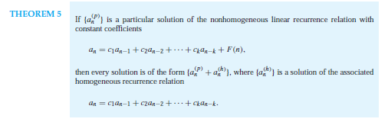
Non homogeneous RR

Slide 53
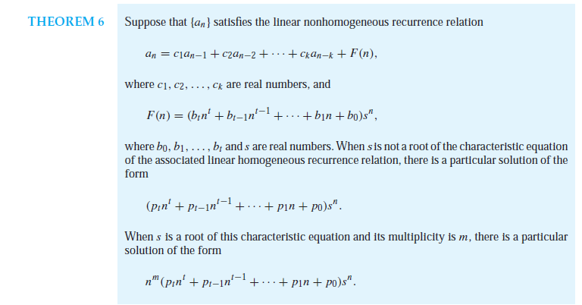
Non homogeneous RR

Slide 54


Slide 55
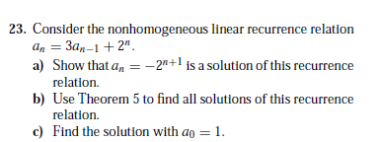

Slide 56
Solving Linear NonHomogeneous Recurrences (3)
Theorem (Theorem 6, p469)
Suppose {a_{n}} satisfies the linear non homogeneous
recurrence relation
a_{n} = c₁a_{n-1} + c₂a_{n-2} + … + c_{k}a_{n-k} + f(n)
where c₁,c₂,..,c_{k} ∈R and
f(n) = (b_{t}n^{t} + b_{t-1}n^{t-1} + .. + b₁n + b₀) s^{n}
F(n) = n³ 1^{n}
where b₀,b₁,..,b_{n},s ∈R
… continues

Slide 57
Solving Linear NonHomogeneous Recurrences (4)
Theorem (Theorem 6, p469)… continued
When s is not a root of the characteristic equation of the associated linear homogeneous recurrence relation, there is a particular solution of the form
(p_{t}n^{t}+ p_{t-1}n^{t-1}+ … +p₁n + p₀) s^{n}
When s is a root of this characteristic equation and its multiplicity is m, there is a particular solution of the form
n^{m}(p_{t}n^{t}+ p_{t-1}n^{t-1}+ … +p₁n + p₀) s^{n}

Slide 58
Generating Functions
Generating functions are used to represent sequences efficiently by coding the terms of a sequence as coefficients of powers of a variable x in a formal power series.
Generating functions can be used to solve many types of counting problems.
Generating functions can be used to solve recurrence relations by translating a recurrence relation for the terms of a sequence into an equation involving a generating function

Slide 59
Generating Functions
This equation can then be solved to find a closed form for the generating function.
From this closed form, the coefficients of the power series for the generating function can be found, solving the original recurrence relation.

Slide 60
Generating Functions
Generating functions can also be used to prove combinatorial identities by taking advantage of relatively simple relationships between functions that can be translated into identities involving the terms of sequences.

Slide 61
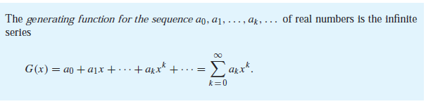

Slide 62
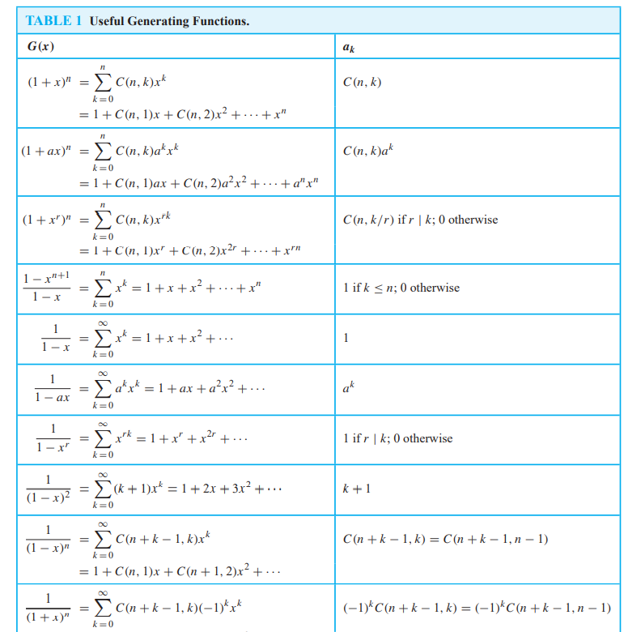
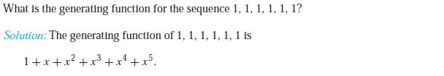

Slide 63
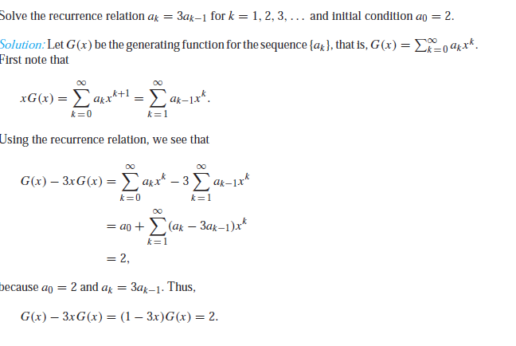

Slide 64
